Slide 1
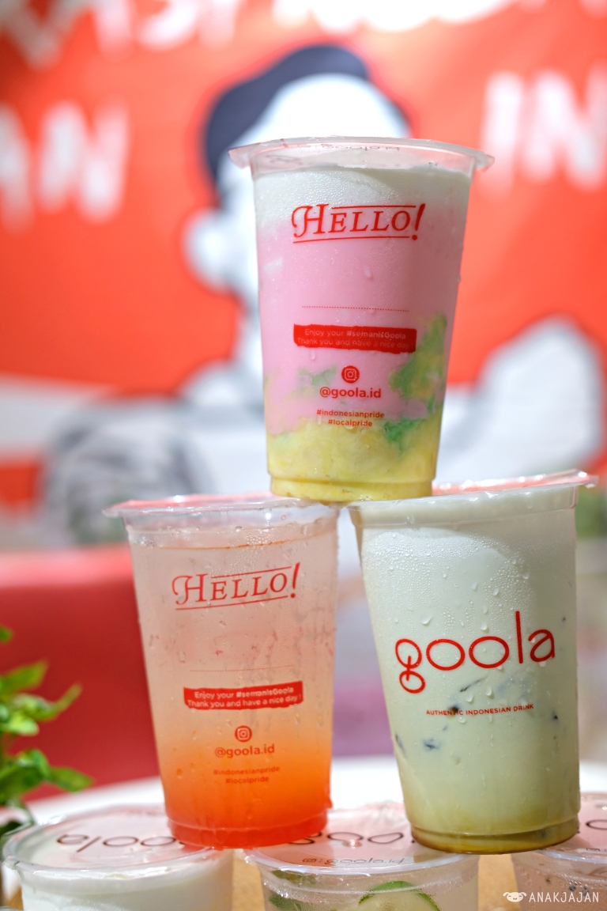
ECOGREEN SOFTDRINKS
REABETSWE SERIBA

